Slide 1
Mulitple Activities and Intent
Session 2
Course : Mobile Community Solution
Effective Period : September 2019

Slide 2
Learning Objectives
At the end of this meeting is expected that students will be able to:
  Describe the main features of Android Programming and Android Software Development
  Produce simple Mobile Application using the main features of Android

Slide 3

Contents
Apps can Contain More Than One Activity
Apps Structure
How Android App works?
Specify Action

Slide 4
What is an Activity? And What Does an Activity do?
An Activity is an application component
Represents one window, one hierarchy of views
Typically fills the screen, but can be embedded in other Activity or a appear as floating window
Java class, typically one Activity in one file
Represents an activity, such as ordering groceries, sending email, or getting directions
Handles user interactions, such as button clicks, text entry, or login verification
Can start other activities in the same or other apps
Has a life cycle—is created, started, runs, is paused, resumed, stopped, and destroyed (will discussed on session 3)

Slide 5
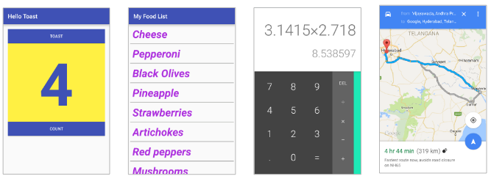
Apps can Contain More Than One Activity
An activity is a single focused thing your user can do. If you chain multiple activities together to do something more complex, It’s called task.
A lot of the time, you’ll want users to do more than just one thing— for example, adding recipes as well as displaying a list of them. If this is the case, you’ll need to use multiple activities: one for displaying the list of recipes and another for adding a single recipe.

Slide 6
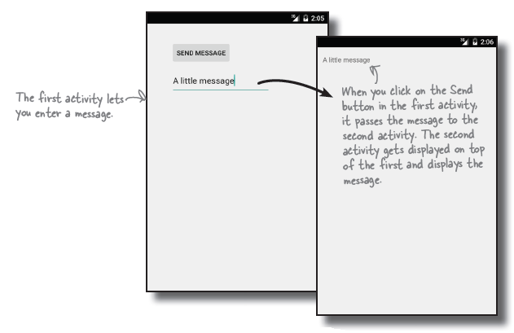
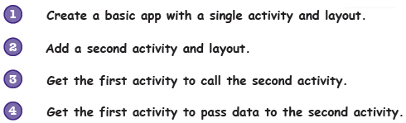
Apps can Contain More Than One Activity (Cont.)

Slide 7
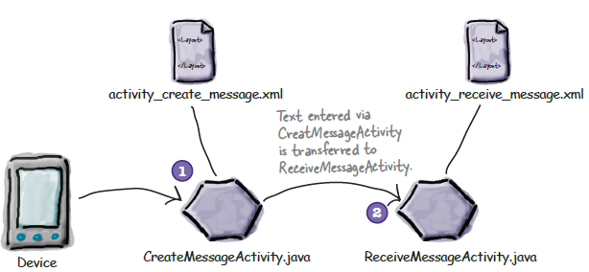
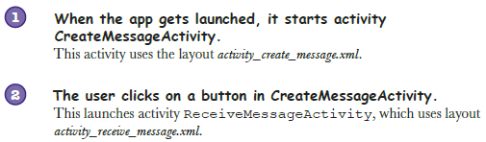
App Structure

Slide 8
Example – Create the 1st activity
Create a new Android Studio project for an application named “Messenger” with a package name of com.hfad.messenger.
The minimum SDK should be API 15 so that it will work on most devices.
You’ll need a blank activity called “CreateMessageActivity” with a layout called “activity_create_message” so that your code matches ours.

Slide 9
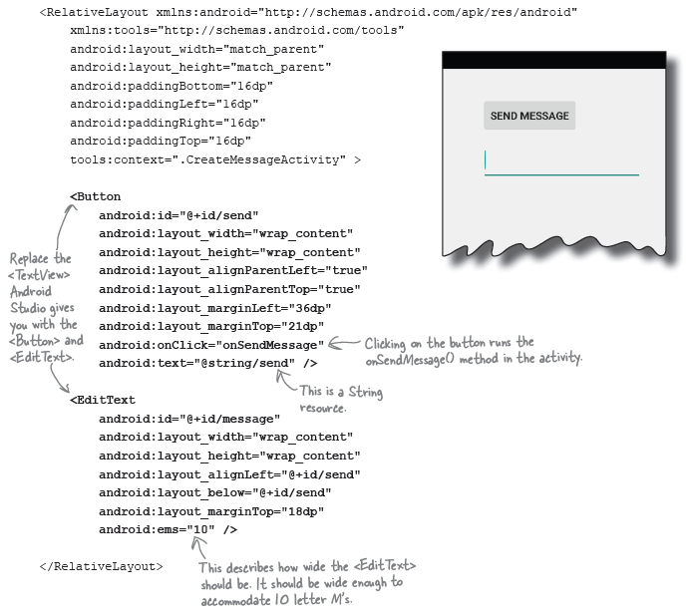
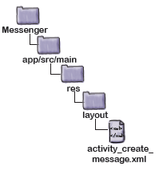
Example – Create the 1st activity

Slide 10
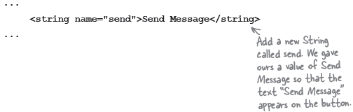
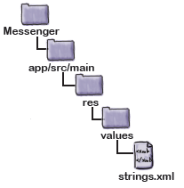
Example – Create the 1st activity
Update string.xml
  The button we added has a text value of @string/send. This means we need to add a string called “send” to strings.xml and give it a value.

Slide 11
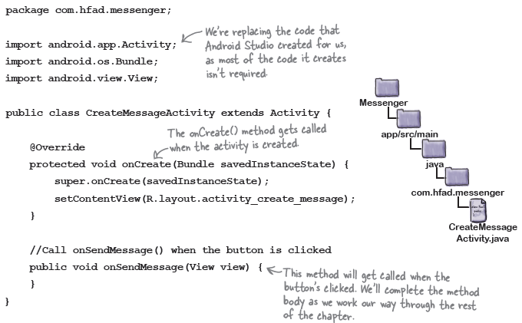
Example – Create the 1st activity
And add method to the activity
  The line in the <Button> element means that the onSendMessage() method in the activity will fire when the button is clicked.
  Open up the CreateMessageActivity.java file and replace the code Android Studio created for you with the following:

Slide 12
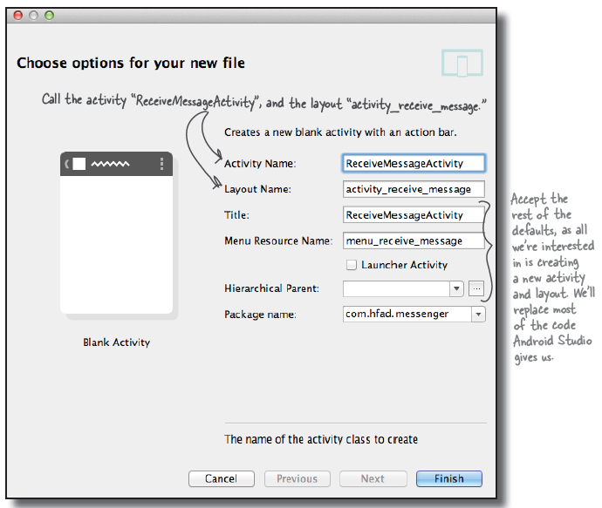
Example – Create 2nd Activity
To create the new activity, choose File → New → Activity, and choose the option for Blank Activity.
Give the new activity a name of “ReceiveMessageActivity” and the layout a name of “activity_receive_message”

Slide 13
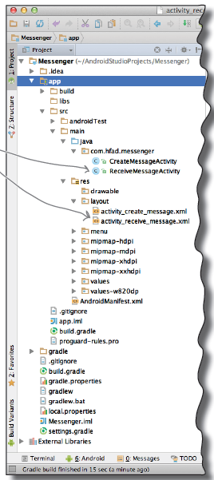
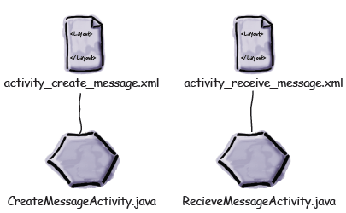
Example – Create 2nd Activity
Each activity uses a different layout. CreateMessageActivity uses the layout activity_ create_message.xml, and ReceiveMessageActivity uses the layout activity_receive_message.xml.

Slide 14
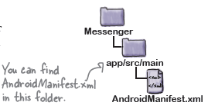
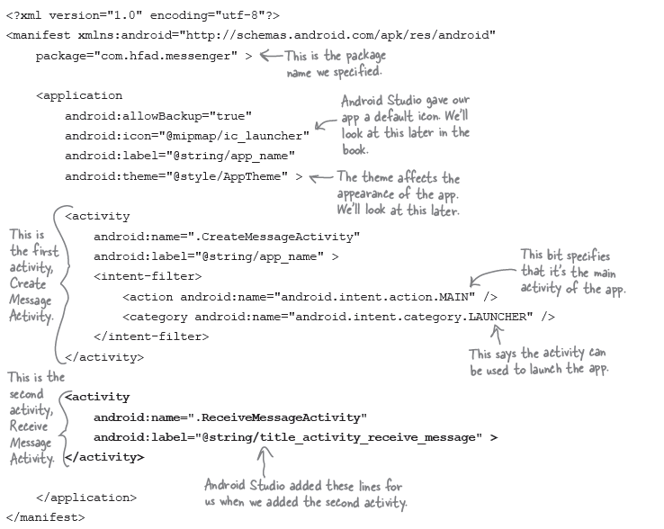
Example – Create 2nd Activity
AndroidManifest.xml

Slide 15
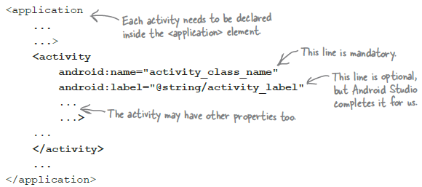
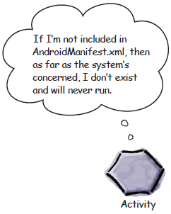
Every activity needs to be declared
All activities need to be declared in AndroidManifest.xml. If an activity isn’t declared in the file, the system won’t know it exists.
You declare an activity in the manifest by including an <activity> element inside the <application> element.

Slide 16
Every activity needs to be declared
The following line is mandatory and is used to specify the class name of the activity::
activity_class_name is the name of the class, prefixed with a “.”. In this case, it’s .ReceiveMessageActivity, because Android combines the class name with the name of the package to derive the fully qualified class name.
This line is optional and is used to specify a user-friendly label for the activity:

Slide 17
Example – Call 2nd Activity
An Intent is a type of message.
When the app is launched, our first activity, CreateMessageActivity, will run. What we need to do next is get CreateMessageActivity to call ReceiveMessageActivity when the user clicks the Send Message button.
Whenever you want an activity to start a second activity, you use an intent. You can think of an intent as an “intent to do something”.
It’s a type of message that allows you to bind separate objects (such as activities) together at runtime. If one activity wants to start a second activity, it does it by sending an intent to Android. Android will start the second activity and pass it the intent.
You can start an activity by creating an intent and using it in the startActivity() method.

Slide 18
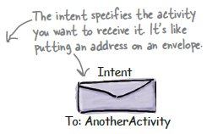

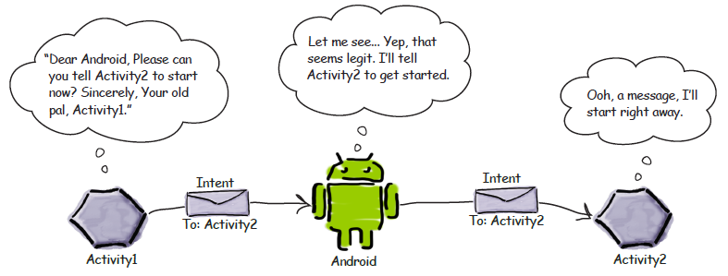
Example – Call 2nd Activity
You start by creating the intent like this:
The first parameter tells Android which object the intent is from, and you can use the word this to refer to the current activity. The second parameter is the class name of the activity that needs to receive the intent.
Once you’ve created the intent, you pass it to Android like this:

Slide 19
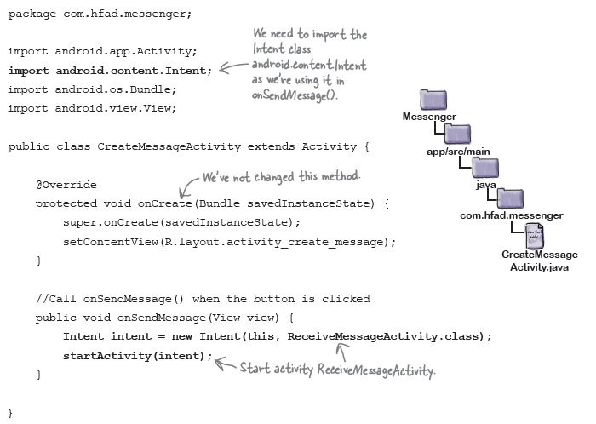
Example – Call 2nd Activity

Slide 20
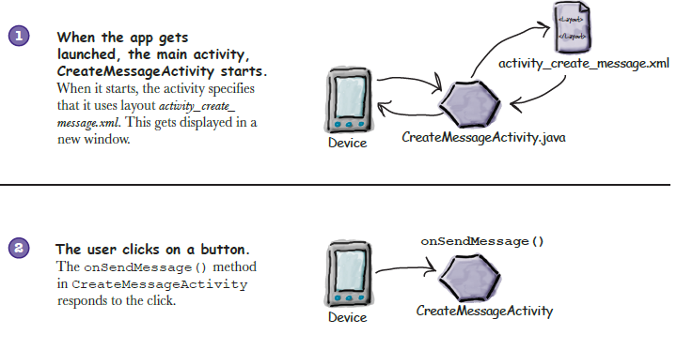
Example – Call 2nd Activity
What happens when you run the app

Slide 21
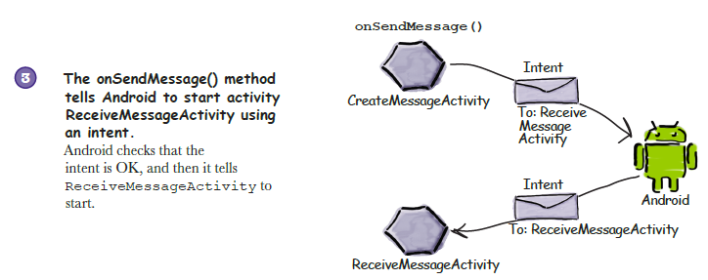
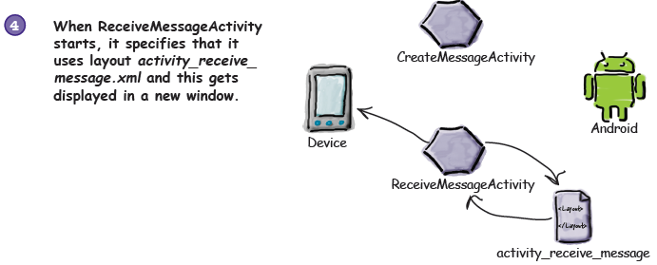
Example – Call 2nd Activity
What happens when you run the app (Cont.)

Slide 22
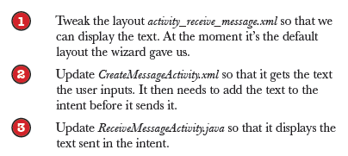
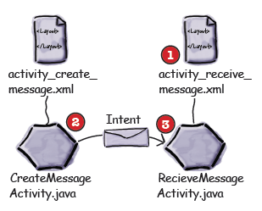
Example – Pass Data
Pass text to a second activity

Slide 23
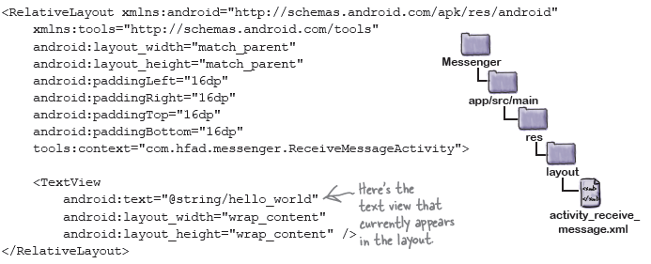
Example – Pass Data
activity_receive_message.xml

Slide 24
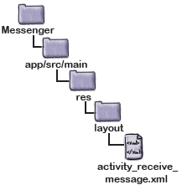
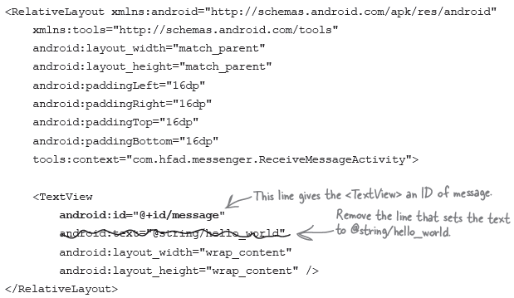
Example – Pass Data
Update the text view properties

Slide 25
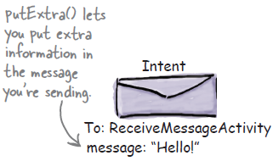
Example – Pass Data
You can add extra information to this intent that can be picked up by the activity you’re targeting so it can react in some way. To do this, you use the putExtra() method.
where message is a String name for the value you’re passing in, and value is the value. The putExtra() method is overloaded so value has many possible types.

Slide 26
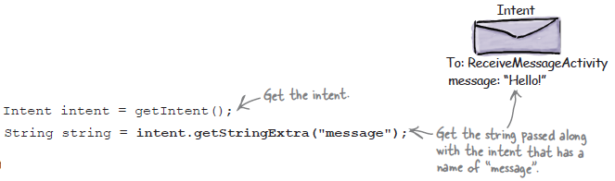
Example – Pass Data
Use getIntent() to retrieve extra information from an intent.
getIntent() returns the intent that started the activity, and you can use this to retrieve any extra information that was sent along with it.

Slide 27
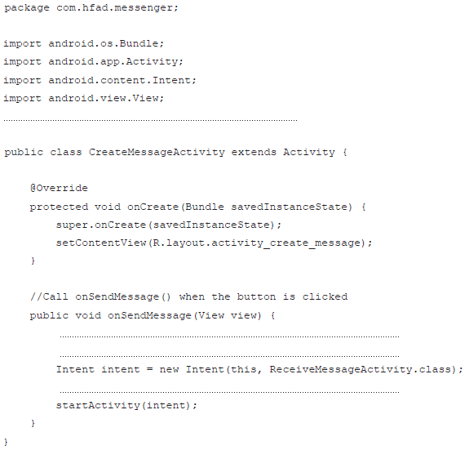
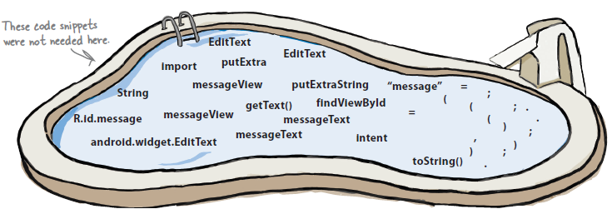
Pool Puzzle

Slide 28
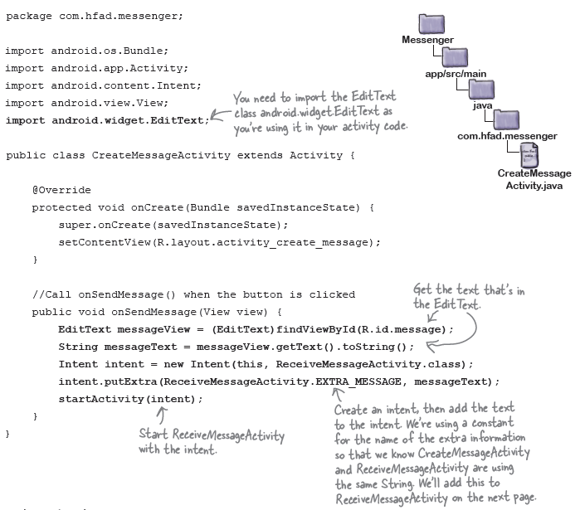
Example – Pass Data
Update the CreateMessageActivity code

Slide 29
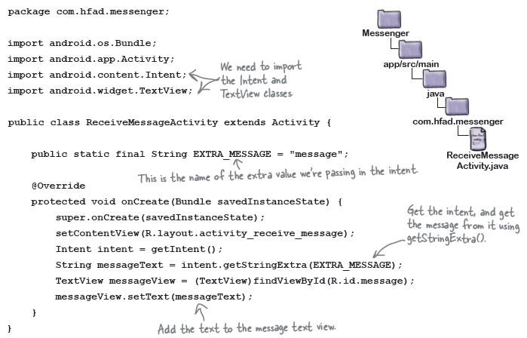
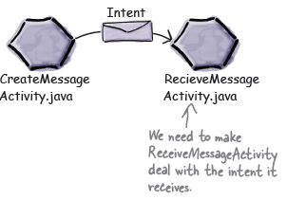
Example – Pass Data
Get ReceiveMessageActivity to use the information in the intent

Slide 30
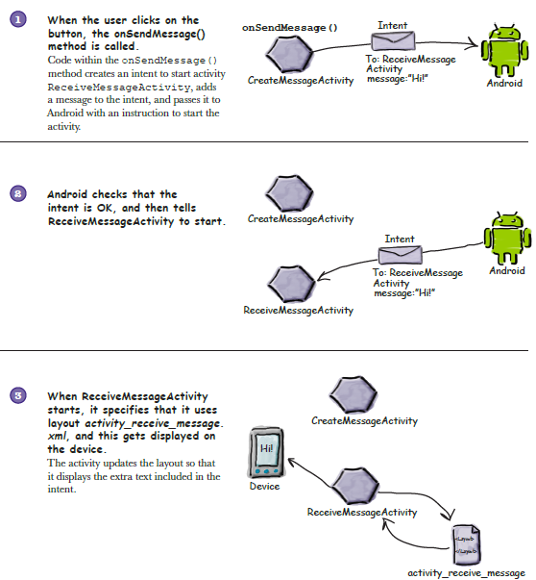
What happens when user clicks the Send Message button

Slide 31
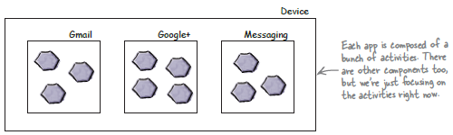
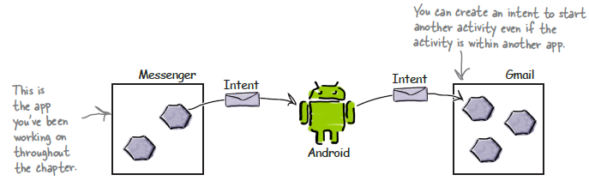
How Android Apps Work
Intents can start activities in other apps

Slide 32
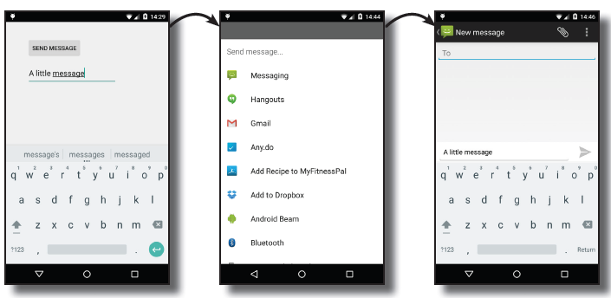
What you are going to do
Create an intent that specifies an action.
The intent will tell Android you want to use an activity that can send a message. The intent will include the text of the message.
Allow the user to choose which app to use.
The chances are there’ll be more than one on the device capable of sending messages, so the user will need to pick one. We want the user to be able to choose one every time they click on the Send Message button.

Slide 33
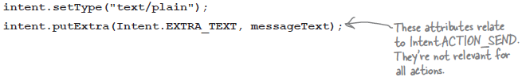

Specify Action
Create an intent that specifies an action
Create an intent
Adding extra information
You can make extra calls to the putExtra() method if there’s additional information you want to add. As an example, if you want to specify the subject of the message, you can also use

Slide 34
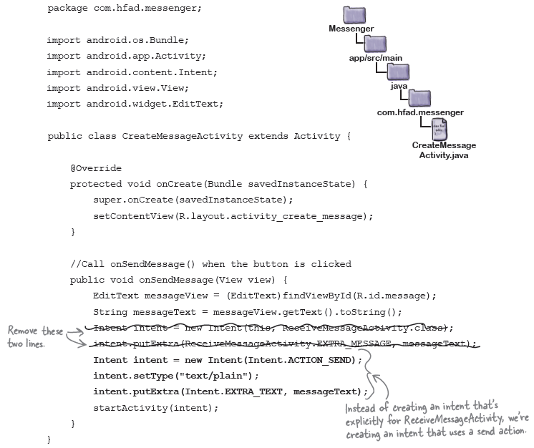
Specify Action
Change the intent that specifies an action

Slide 35
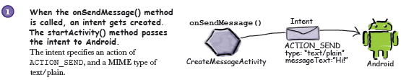
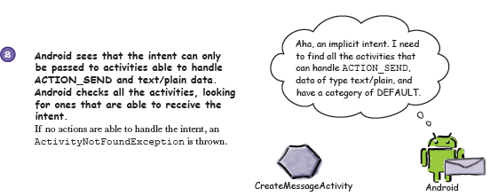
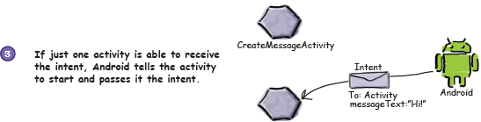
What happens when the code runs

Slide 36
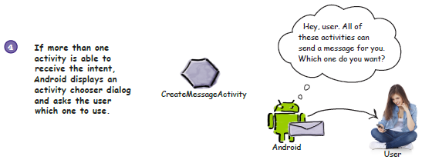
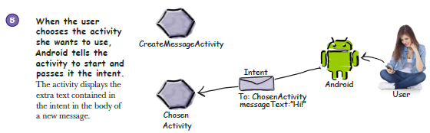
What happens when the code runs (cont.)

Slide 37
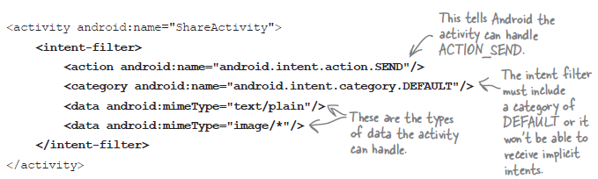
The intent filter tells Android which activities can handle which actions
When Android is given an intent, it has to figure out which activity, or activities, are able to handle it. This process is known as intent resolution.
When you use an explicit intent,the following code explicitly tells Android to start ReceiveMessageActivity:
When you use an implicit intent

Slide 38

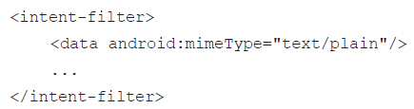
How Android Uses the Intent Filter
Android first considers intent filters that include a category of android.intent.category.DEFAULT:
Similarly, if the intent MIME type is set to “text/plain” using
Android will only consider activities that can accommodate this type of data:

Slide 39
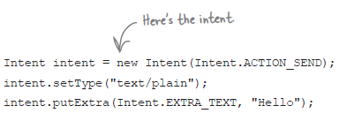
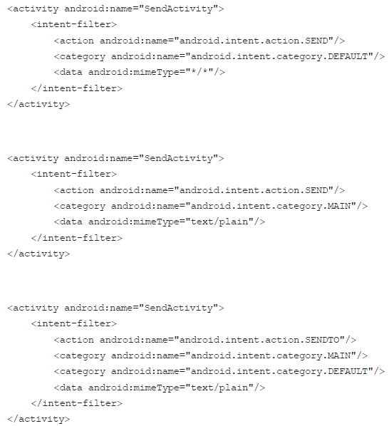


Slide 40



You need to run your app on a REAL device

Slide 41




Running your app on a real device (continued)

Slide 42


Test Drive
If you have one activity
If you have more than one activity

Slide 43


What if you ALWAYS want your users to choose an activity?
createChooser() allows you to specify a title for the chooser dialog, and doesn’t give the user the option of selecting an activity to use by default. It also lets the user know if there are no matching activities by displaying a message.
Intent.createChooser() displays a chooser dialog
To start activity:

Slide 44



What happens when you call createChooser()

Slide 45



What happens when you call createChooser() (Cont.)

Slide 46



Change the code to create a chooser
Update strings.xml...
and update the onSendMessage() method
The getString() method is used to get the value of a string resource. It takes one parameter, the ID of the resource (in our case, this is R.string.chooser):

Slide 47

Test drive the App
If you have one activity

Slide 48


Test drive the App
If you have more than one activity
If you have NO matching activities

Slide 49

Summary

Slide 50
References
Head First Android Development. 2nd Edition. A Brain friendy guide. Dawn Griffiths and David Griffiths.O’reilly. ISBN:978-1-449-36218-8. Chapter 3

